Slide 1
Express JS Fast, unopinionated, minimalist web framework for Node.js
UNIT 2

Slide 2
Express is a minimal and flexible Node.js web application framework that provides a robust set of features for web and mobile applications.
APIs With a myriad of HTTP utility methods and middleware at your disposal, creating a robust API is quick and easy.

Slide 3
Express.js is a fast, flexible and minimalist web framework for Node.js. It’s effectively a tool that simplifies building web applications and APIs using JavaScript on the server side. Express is an open-source that is developed and maintained by the Node.js foundation.
Express.js offers a robust set of features that enhance your productivity and streamline your web application. It makes it easier to organize your application’s functionality with middleware and routing. It adds helpful utilities to Node HTTP objects and facilitates the rendering of dynamic HTTP objects.

Slide 4
Why learn Express?
Express is a user-friendly framework that simplifies the development process of Node applications.
It uses JavaScript as a programming language and provides an efficient way to build web applications and APIs.
With Express, you can easily handle routes, requests, and responses, which makes the process of creating robust and scalable applications much easier.
Moreover, it is a lightweight and flexible framework that is easy to learn and comes loaded with middleware options.
Whether you are a beginner or an experienced developer, Express is a great choice for building your application.

Slide 5
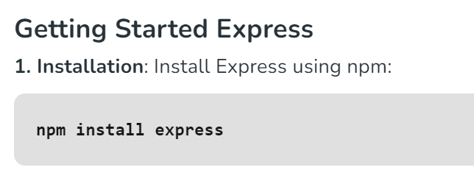

Slide 6
Example 1
const express = require('express');
const app = express();
// Define routes and middleware here
// ...
const PORT = process.env.PORT || 3000;
app.listen(PORT, () => {
console.log(`Server running on port ${PORT}`);
});

Slide 7
Explanation:
Import the ‘express’ module to create a web application using Node.js.
Initialize an Express app using const app = express();.
Add routes (endpoints) and middleware functions to handle requests and perform tasks like authentication or logging.
Specify a port (defaulting to 3000) for the server to listen on.

Slide 8
Key Features of Express
1. Middleware and Routing: Define clear pathways (routes) within your application to handle incoming HTTP requests (GET, POST, PUT, DELETE) with ease. Implement reusable functions (middleware) to intercept requests and create responses, adding functionalities like authentication, logging, and data parsing.

Slide 9
Middleware in web development, particularly in the context of frameworks like Express.js, refers to functions or pieces of code that sit between the incoming request from the client and the final handling of the response by the server.
It acts as a bridge that processes incoming requests before they reach the main application logic or after the response is generated.

Slide 10
Routing defines how an application responds to a client request for a specific endpoint, which could be a URL and an HTTP method (GET, POST, etc.).
You can use middleware within routes to perform specific tasks before sending the response.

Slide 11
2. Minimalistic Design: Express.js follows a simple and minimalistic design philosophy. This simplicity allows you to quickly set up a server, define routes, and handle HTTP requests efficiently. It’s an excellent choice for building web applications without unnecessary complexity.

Slide 12
3. Flexibility and Customization: Express.js doesn’t impose a strict application architecture. You can structure your code according to your preferences. Whether you’re building a RESTful API or a full-fledged web app, Express.js adapts to your needs.
4. Templating Power: Incorporate templating engines like Jade or EJS to generate dynamic HTML content, enhancing user experience.

Slide 13
Jade is a templating engine that is primarily used with Node.js to generate HTML dynamically. It allows developers to write more concise and readable code for creating HTML by using a simplified syntax. Jade was later renamed to Pug, but the concepts remain the same

Slide 14
EJS (Embedded JavaScript) is a templating engine used in Node.js applications to generate HTML pages dynamically. It allows you to embed JavaScript code within your HTML markup. EJS enables you to write simple logic in your HTML, such as loops and conditionals, and insert data dynamically into the web pages from the backend.

Slide 15
5. Static File Serving: Effortlessly serve static files like images, CSS, and JavaScript from a designated directory within your application.
6. Node.js Integration: Express.js seamlessly integrates with the core functionalities of Node.js, allowing you to harness the power of asynchronous programming and event-driven architecture.

Slide 16
Applications of Express
Express.js empowers you to construct a wide array of web applications. Here are some captivating examples:
RESTful APIs: Develop robust APIs that adhere to the REST architectural style, enabling communication with other applications and front-end interfaces.
Real-time Applications: Leverage Express.js’s event-driven nature to create real-time applications like chat or collaborative editing tools.
Single-Page Applications (SPAs): Craft SPAs that fetch and update content dynamically on the client-side, offering a seamless user experience.

Slide 17
Server Side Rendering using Express.js And EJS Template Engine
Server-side rendering involves generating HTML on the server and sending it to the client, as opposed to generating it on the client side using JavaScript. This improves initial load time, and SEO, and enables dynamic content generation.
Express is a popular web application framework for NodeJS, and
EJS is a simple templating language that lets you generate HTML with plain JavaScript.

Slide 18
Basic Approach:
Using Express with EJS templating engine to render HTML on the server side.
In this approach, we set up an Express server with EJS as the templating engine.
We define routes and render EJS templates directly. Data can be passed to the templates as variables.

Slide 19
Advanced Approach (with Data Fetching):
Utilizing asynchronous data fetching within Express routes to dynamically render content with EJS.
This approach extends the basic one by incorporating asynchronous data fetching within Express routes. This could involve fetching data from databases, external APIs, or other sources before rendering the EJS templates.

Slide 20
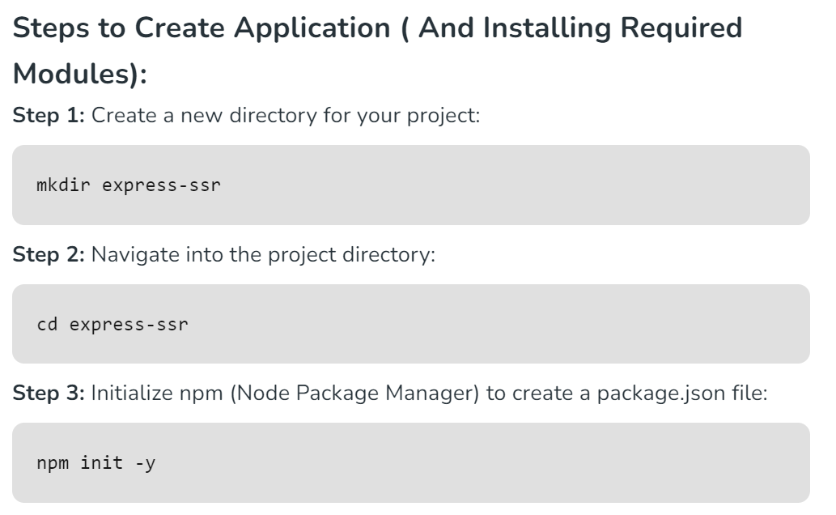

Slide 21
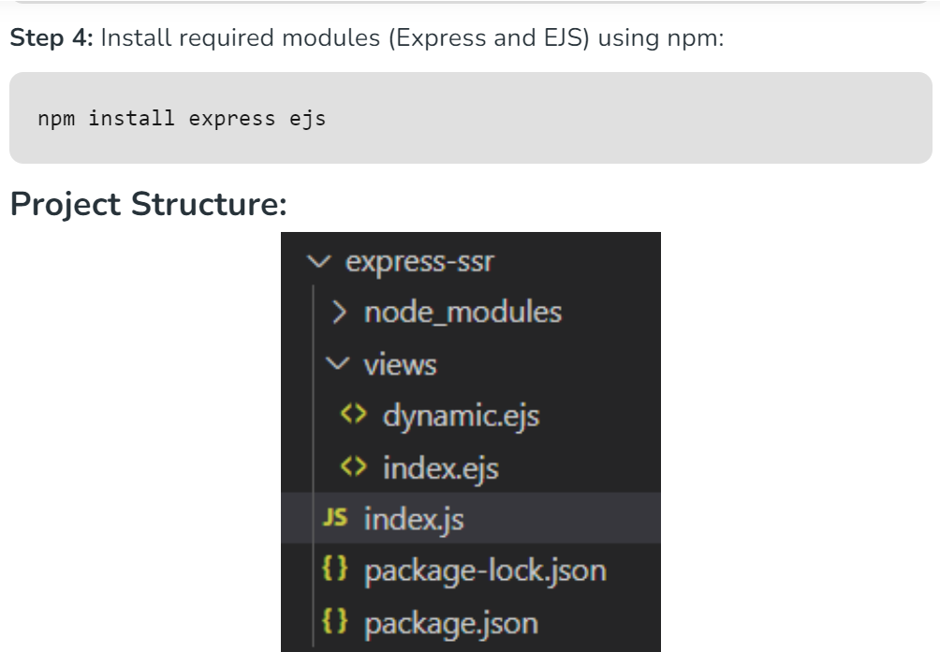

Slide 22
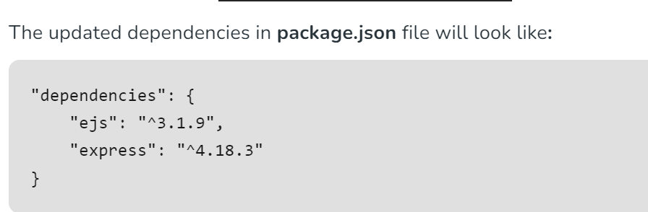

Slide 23
//views/index.ejs
<!DOCTYPE html>
<html lang="en">
<head>
<meta charset="UTF-8">
<meta name="viewport" content="width=device-width, initial-scale=1.0">
<title>Express SSR with EJS</title>
</head>
<body>
<h1>Hello, <%= name %>!</h1>
</body>
</html>

Slide 24
//views/dynamic.ejs
<!DOCTYPE html>
<html lang="en">
<head>
<meta charset="UTF-8">
<meta name="viewport" content="width=device-width, initial-scale=1.0">
<title>Express SSR with EJS</title>
</head>
<body>
<h1>Dynamic Content: <%= data %></h1>
</body>
</html>

Slide 25
const express = require('express');
const app = express();
const path = require('path');
// Set the view engine to EJS
app.set('view engine', 'ejs');
app.set('views', path.join(__dirname, 'views'));
// Basic Approach: Render EJS template with static data
app.get('/', (req, res) => {
res.render('index', { name: 'World' });
});
/*
Advanced Approach: Render EJS template
with asynchronously fetched data
*/
app.get('/dynamic', async (req, res) => {
const dynamicData = await fetchData();
res.render('dynamic', { data: dynamicData });
});

Slide 26
// Function to simulate asynchronous data fetching
async function fetchData() {
return new Promise(resolve => {
setTimeout(() => {
resolve('Dynamic Content');
}, 1000);
});
}
// Start the server
const PORT = process.env.PORT || 3000;
app.listen(PORT, () => {
console.log(`Server is running on port ${PORT}`);
});

Slide 27
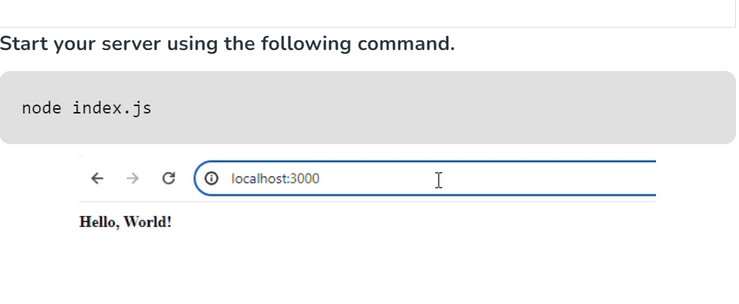

Slide 28
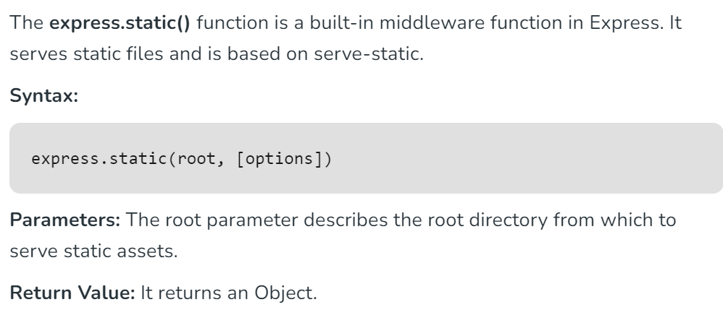
Express express.static() Function

Slide 29
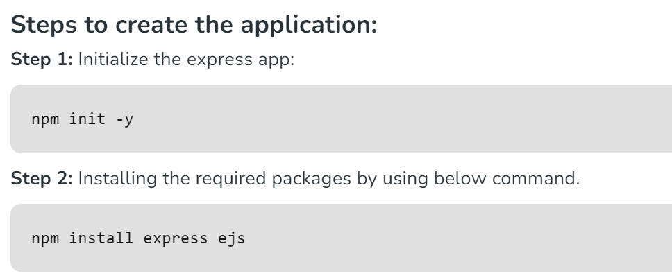

Slide 30
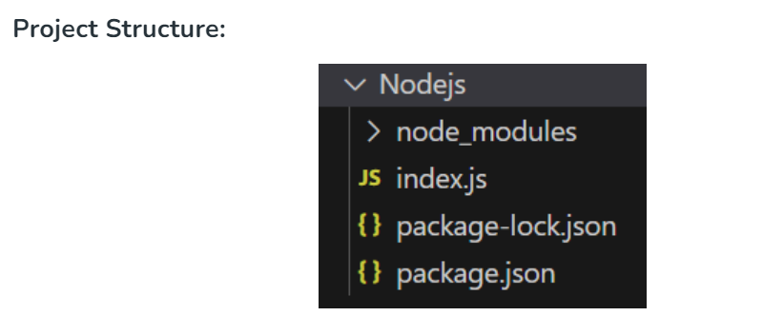

Slide 31
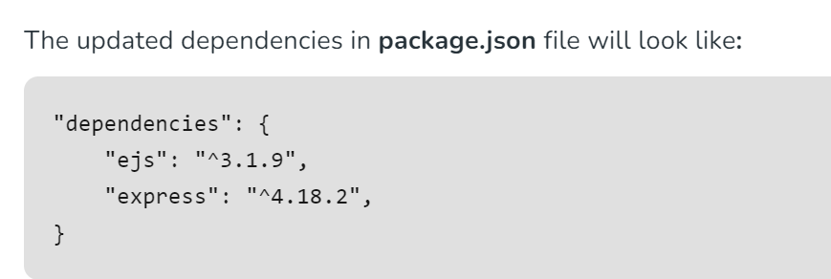

Slide 32
const express = require('express');
const app = express();
const path = require('path');
const PORT = 3000;
// Static Middleware
app.use(express.static(path.join(__dirname, 'public')))
app.get('/', function (req, res, next) {
res.render('home.ejs');
})
app.listen(PORT, function (err) {
if (err) console.log(err);
console.log("Server listening on PORT", PORT);
});

Slide 33
<!DOCTYPE html>
<html>
<head>
<title>express.static() Demo</title>
</head>
<body>
<h2>Greetings from GeeksforGeeks</h2>
<img src="Demo.jpg" width="150" height="100" />
</body>
</html>

Slide 34
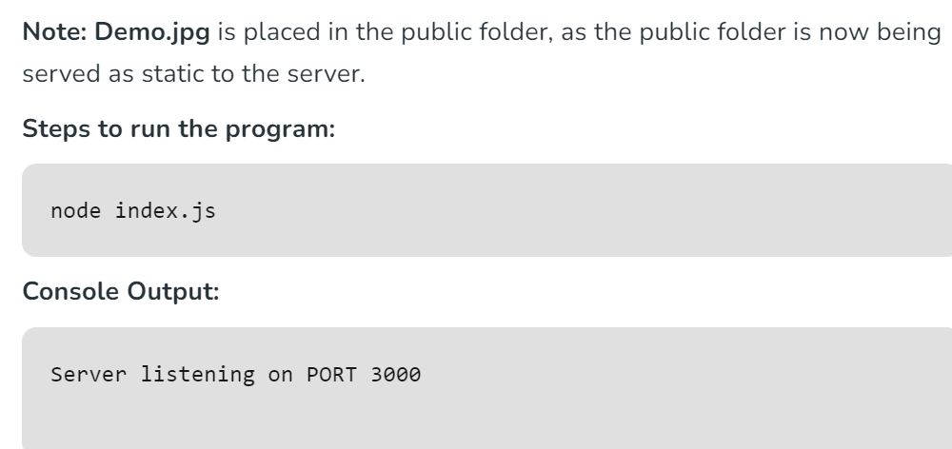

Slide 35
